Slide 1
Logo
Name/Banner
Pic
Customer Portal
Internal Portal

Slide 2
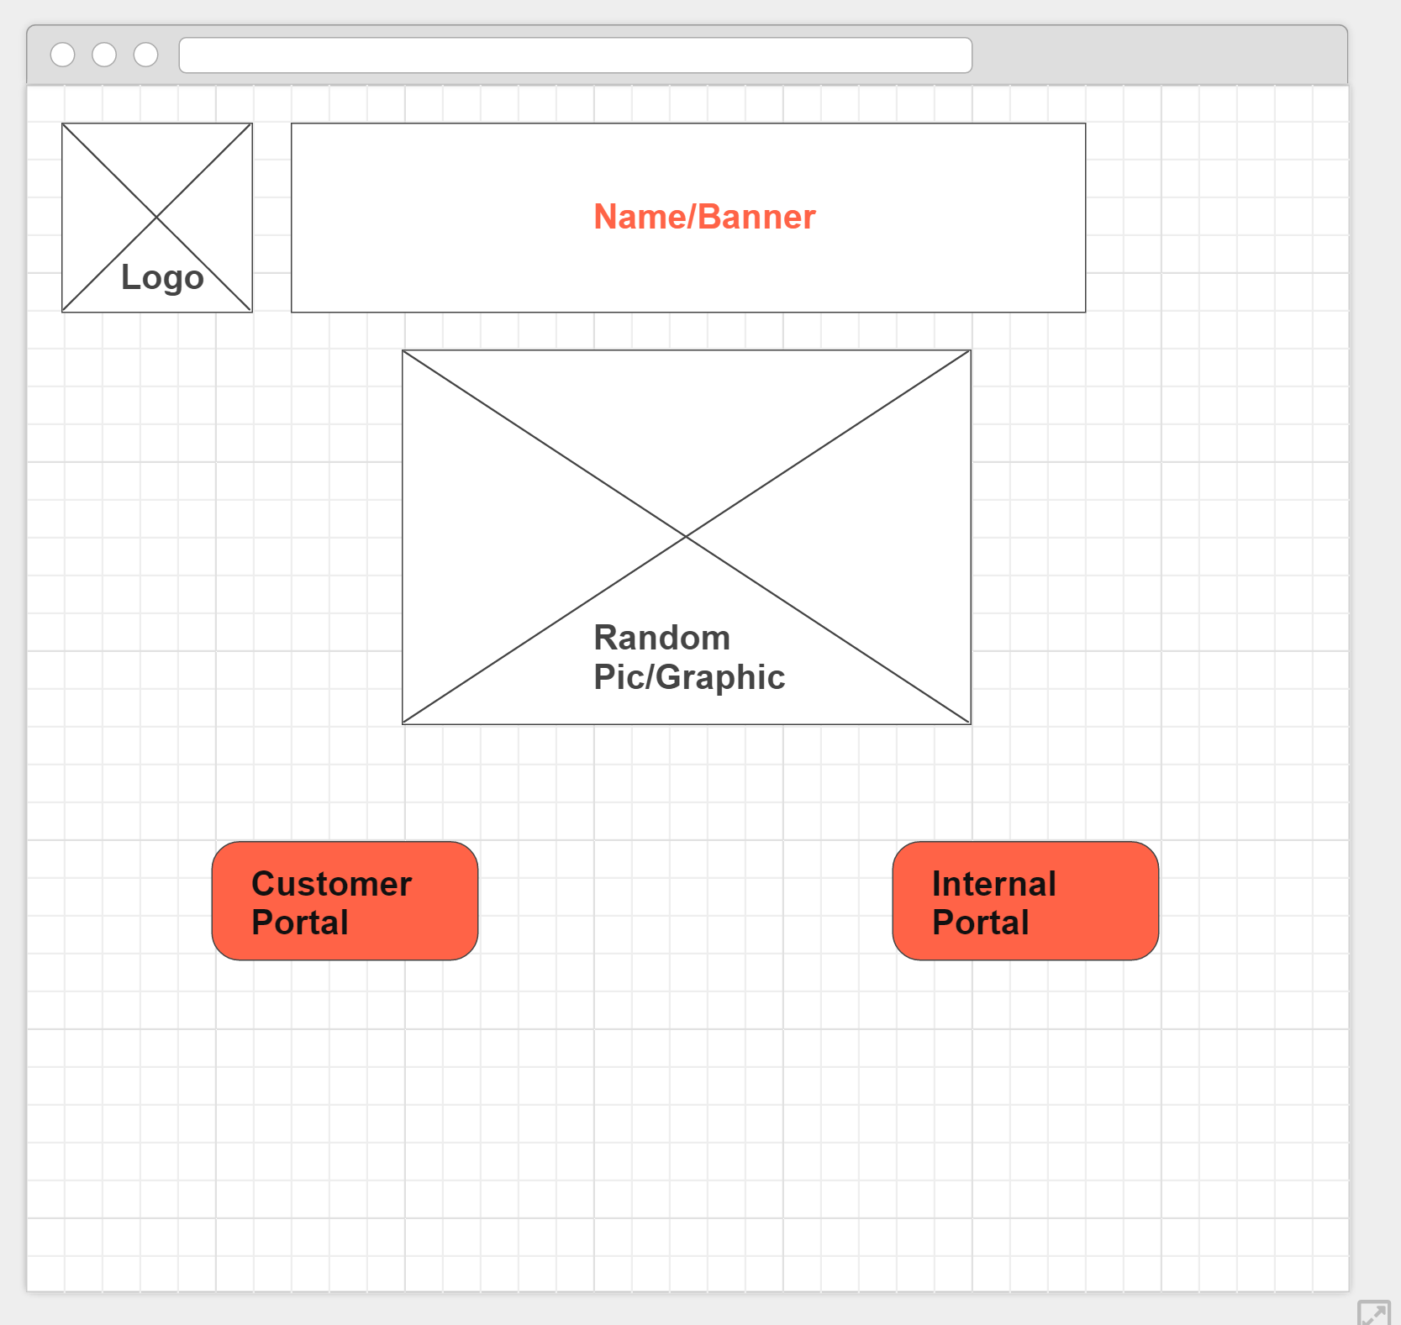

Slide 3
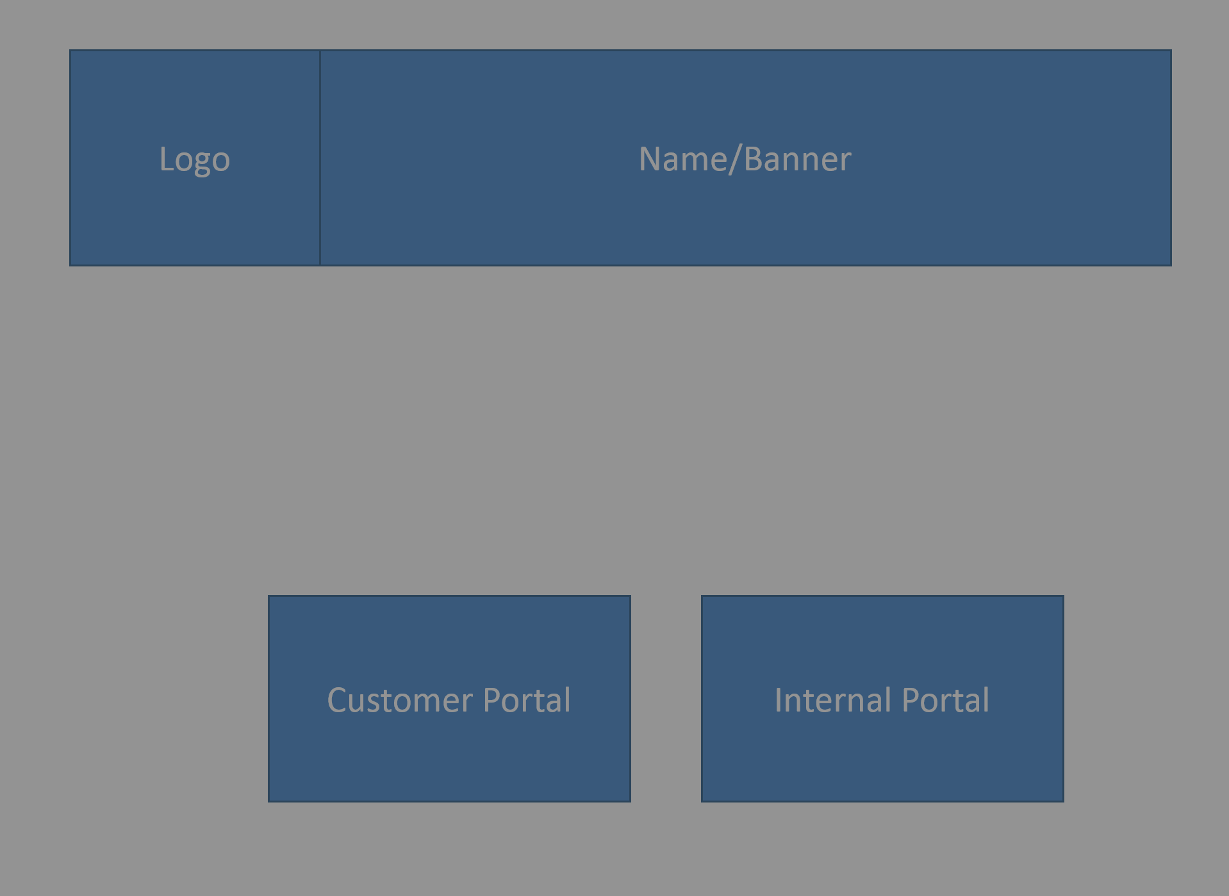
Insert Email:
Submit

Slide 4
Customer Portal
Sign Out
New Order
Order History

Slide 5
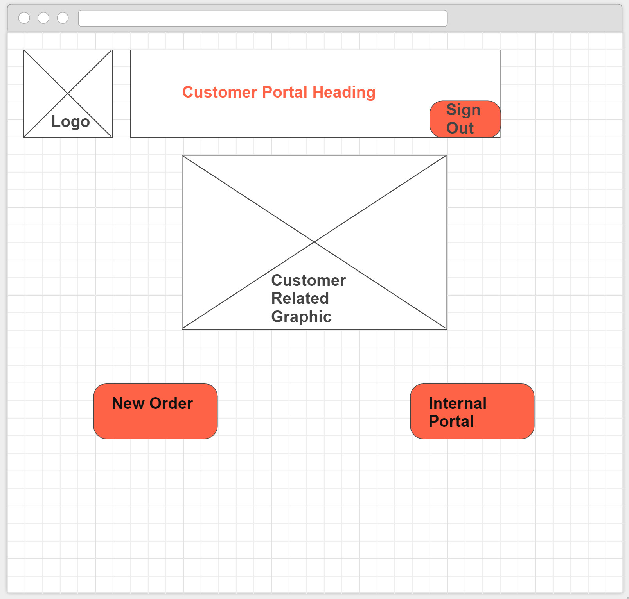

Slide 6
New Order
Sign Out
Nav Menu
Home
>New Order
Order History
Sender Details
First Name: |  | Last Name:
Business Name:
Contact: |  | Email:
Shop/Unit: |  | Street Number:
Street Name:
Suburb/City: |  | Post Code:

Slide 7
(same webpage as previous slide)
Receiver Details
First Name: |  | Last Name:
Business Name:
Contact: |  | Email:
Shop/Unit: |  | Street Number:
Street Name:
Suburb/City: |  | Post Code:
Next

Slide 8
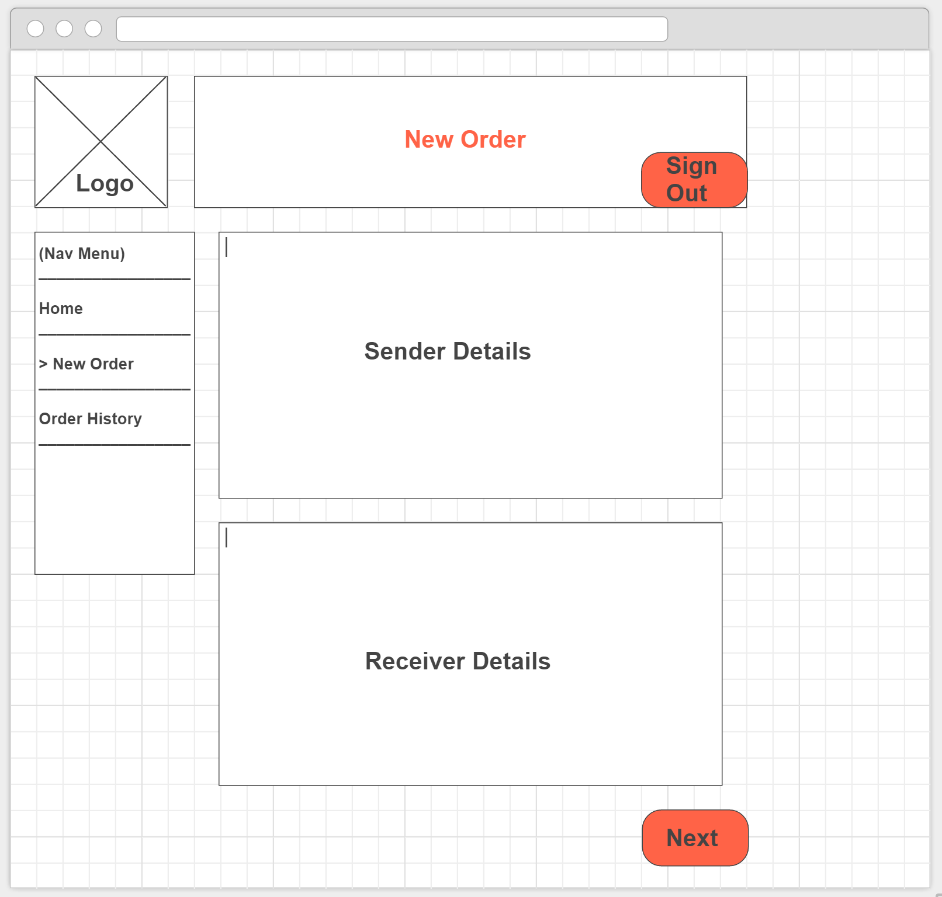

Slide 9
Order Confirmation Page (not editable)
Nav Menu
Home
>New Order
Order History
Sender Details
First Name: |  | Last Name:
Business Name:
Contact: |  | Email:
Shop/Unit: |  | Street Number:
Street Name:
Suburb/City: |  | Post Code:
Receiver Details
First Name: |  | Last Name:
Business Name:
Contact: |  | Email:
Shop/Unit: |  | Street Number:
Street Name:
Suburb/City: |  | Post Code:
Edit
Continue

Slide 10
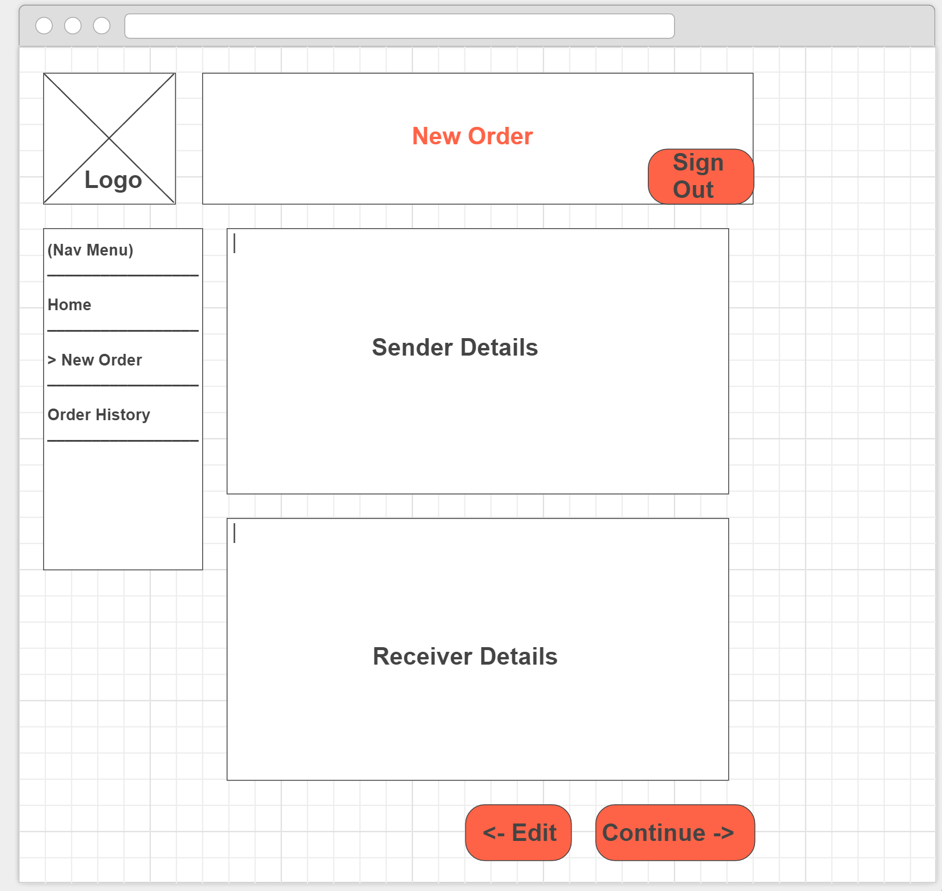

Slide 11
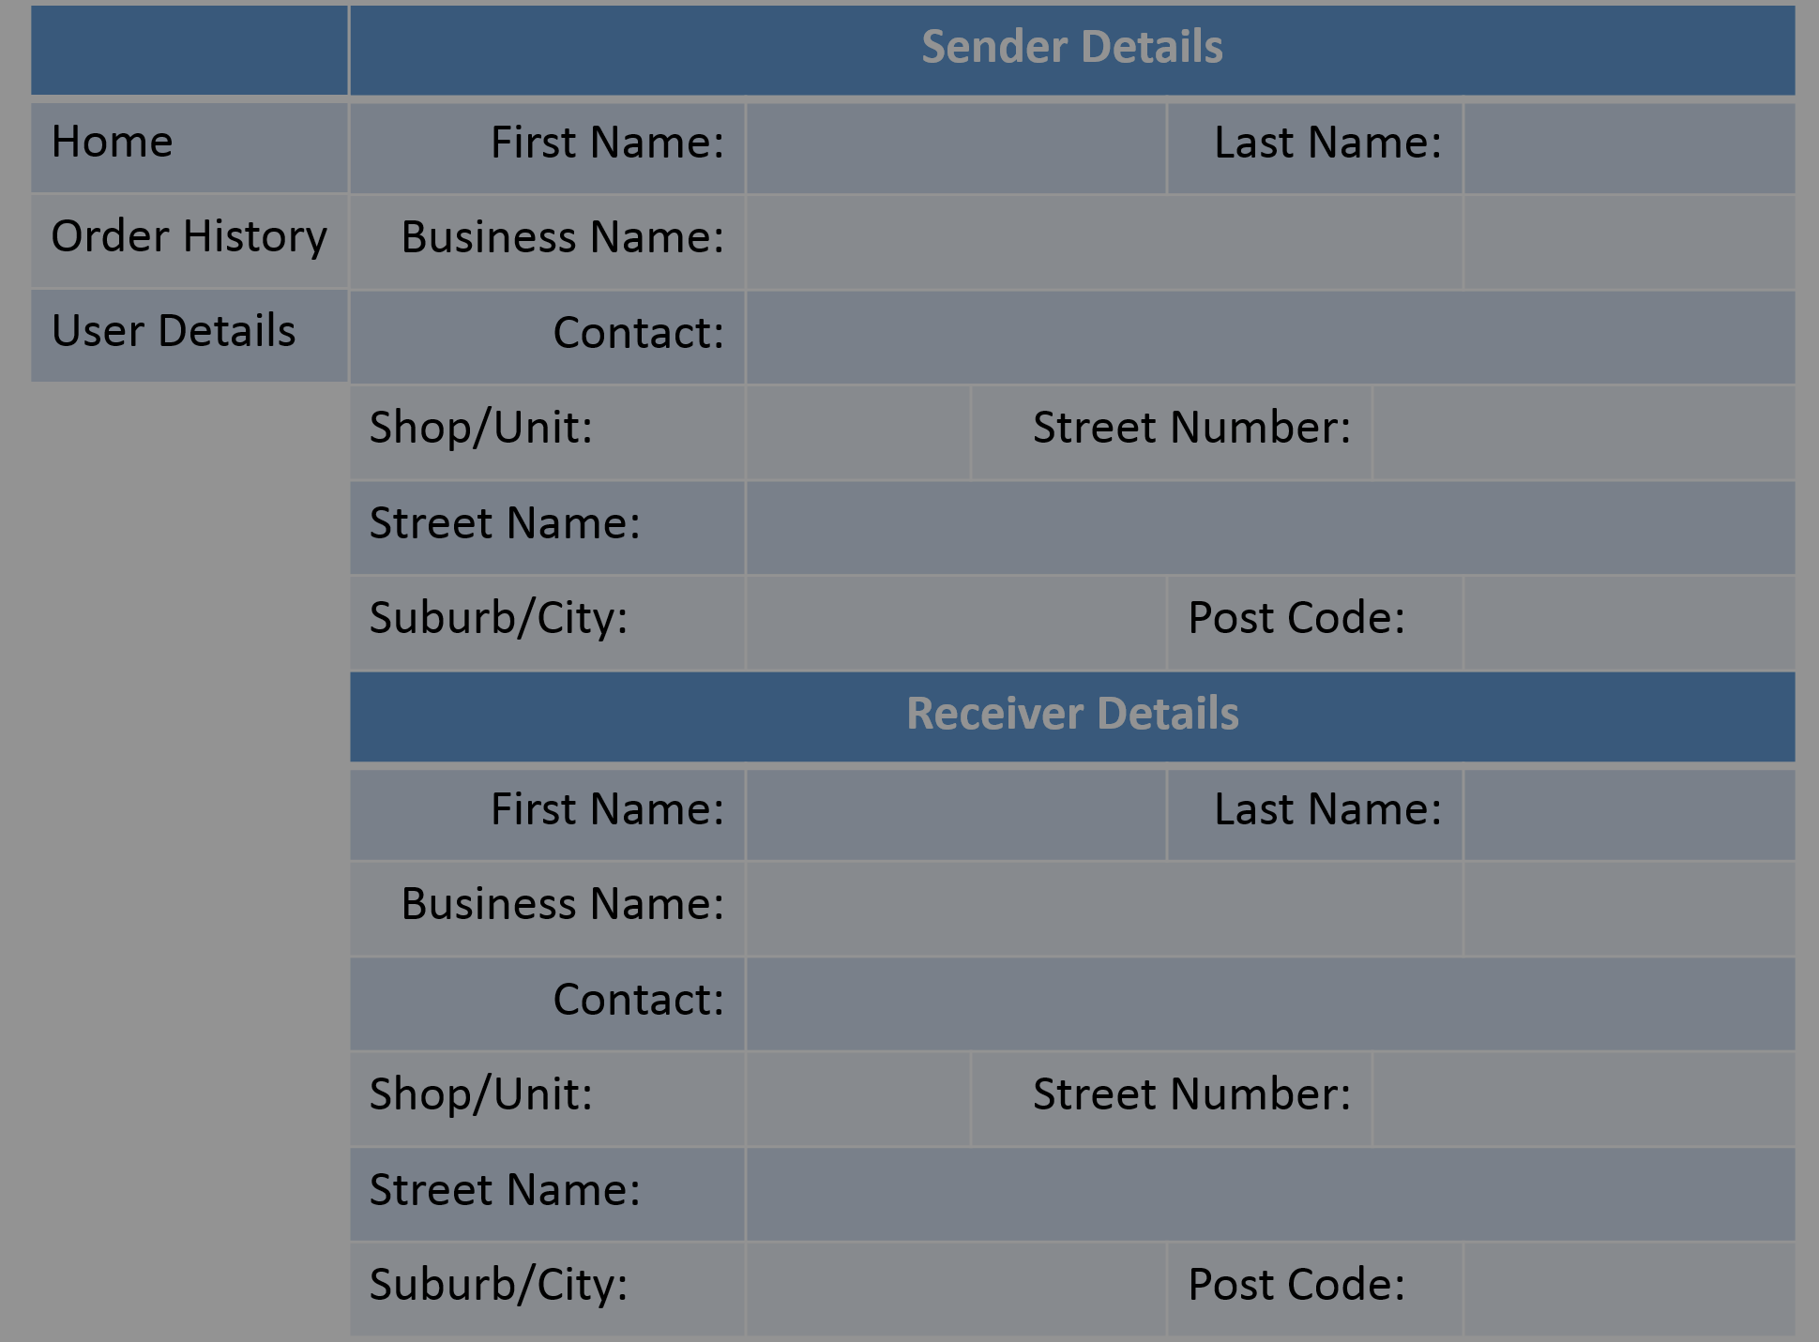
Your order has been successfully submitted.
Order Number: 00000000
Back to Home

Slide 12
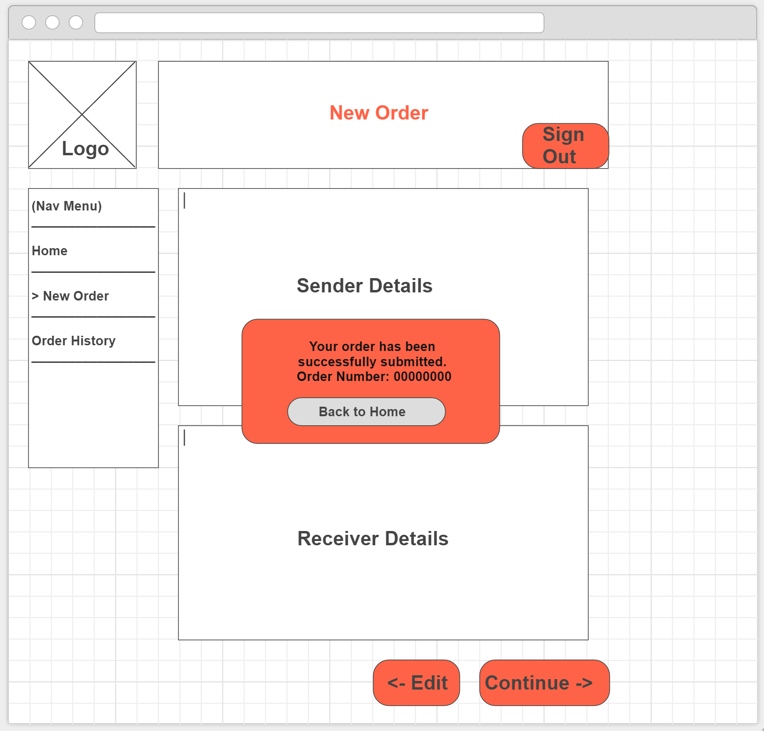

Slide 13
Order History
Sign Out
Nav Menu
Home
New Order
>Order History
Pending Orders
Completed Orders

Slide 14
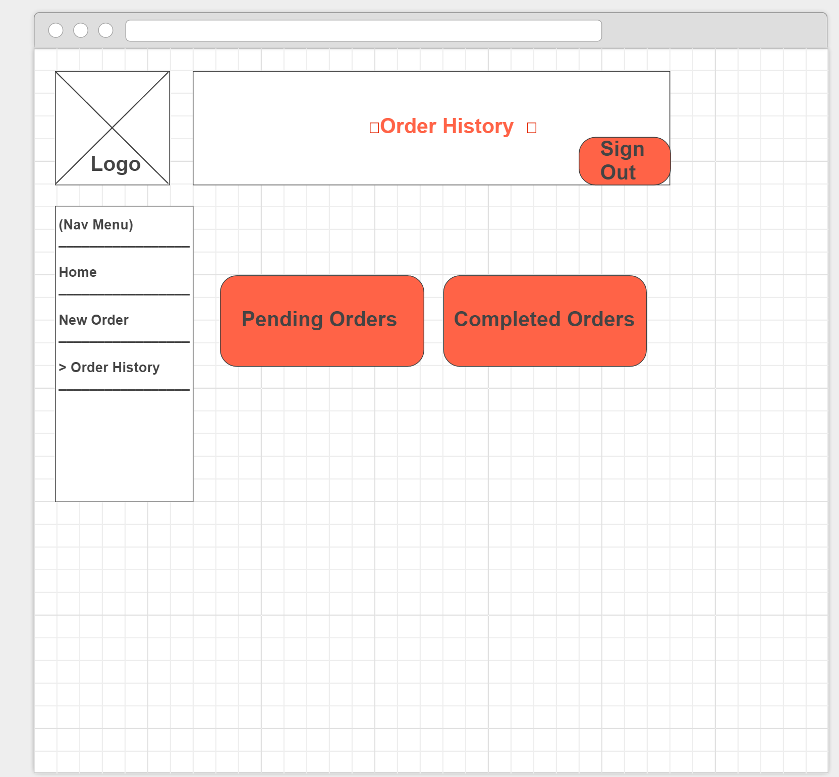

Slide 15
Pending Orders
Sign Out
Nav Menu
Home
New Order
>Order History
>> Pending Orders
Order #: 123 Date:00/00/0000
Destination: 1/123 Queen Street, Brisbane 4000
Receiver: XYZ
Contact Number: 0400000000
Order #: 456 Date:00/00/0000
Destination: 456 Queen Street, Brisbane 4000
Receiver: XYZ
Contact Number: 0400000000
Order #: 789 Date:00/00/0000
Destination: 789 Queen Street, Brisbane 4000
Receiver: XYZ
Contact Number: 0400000000
(Click to view Order)

Slide 16
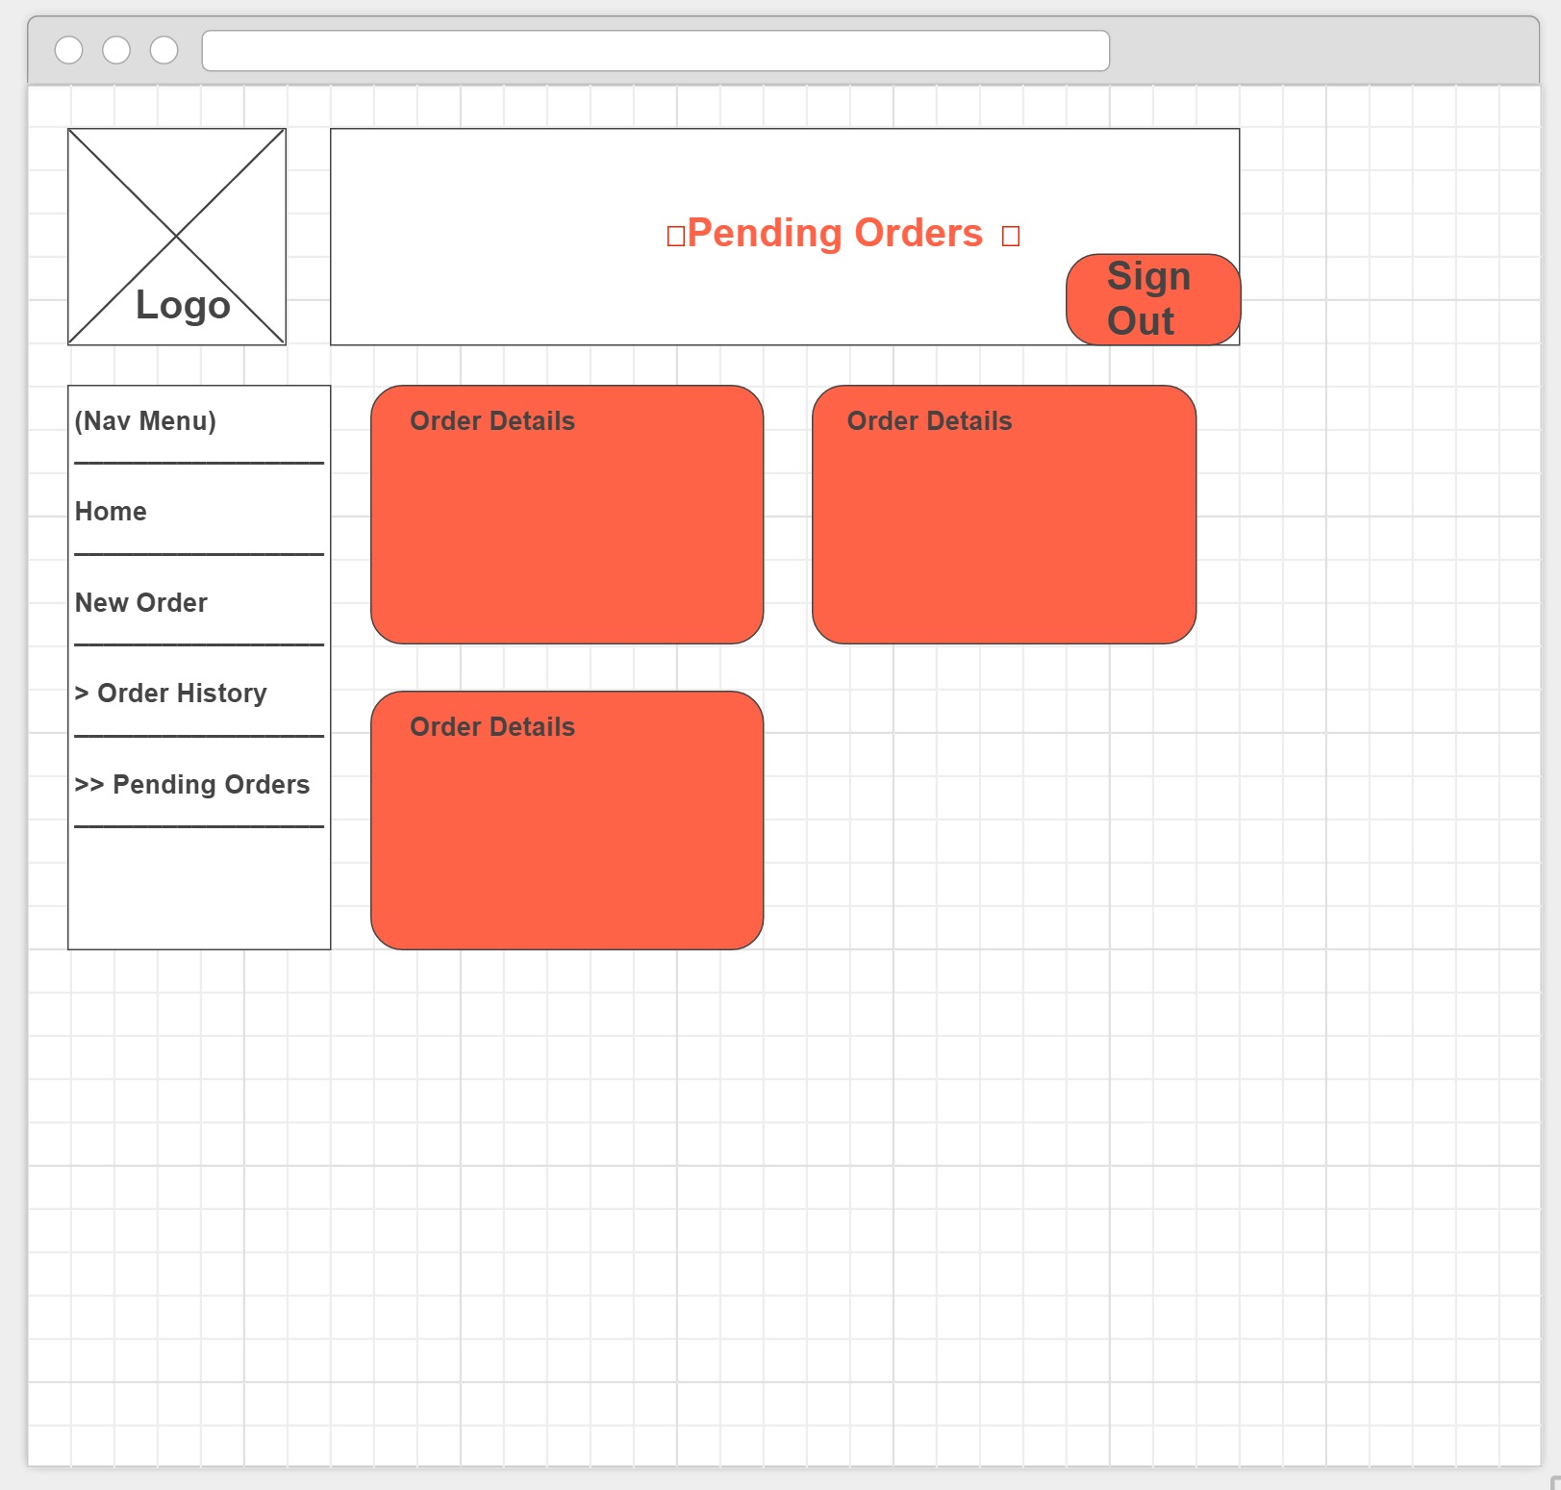

Slide 17
Pending Orders
Sign Out
Nav Menu
Home
New Order
>Order History
>> Pending Orders
Order: 123
Sender Details
First Name: | abc | Last Name: | Def
Business Name:
Contact: | 0400000001
Shop/Unit: |  | Street Number: | 123
Street Name: | Ann Street
Suburb/City: | Brisbane | Post Code: | 4000
Receiver Details
First Name: |  | Last Name:
Business Name: | CYX Pty ltd
Contact: | 04000000000
Shop/Unit: | 1 | Street Number: | 123
Street Name: | Queen Street
Suburb/City: | Brisbane | Post Code: | 4000
Delivery Status: | Awaiting Processing at Warehouse | Estimated Delivery: | 09/09/2016
Back

Slide 18
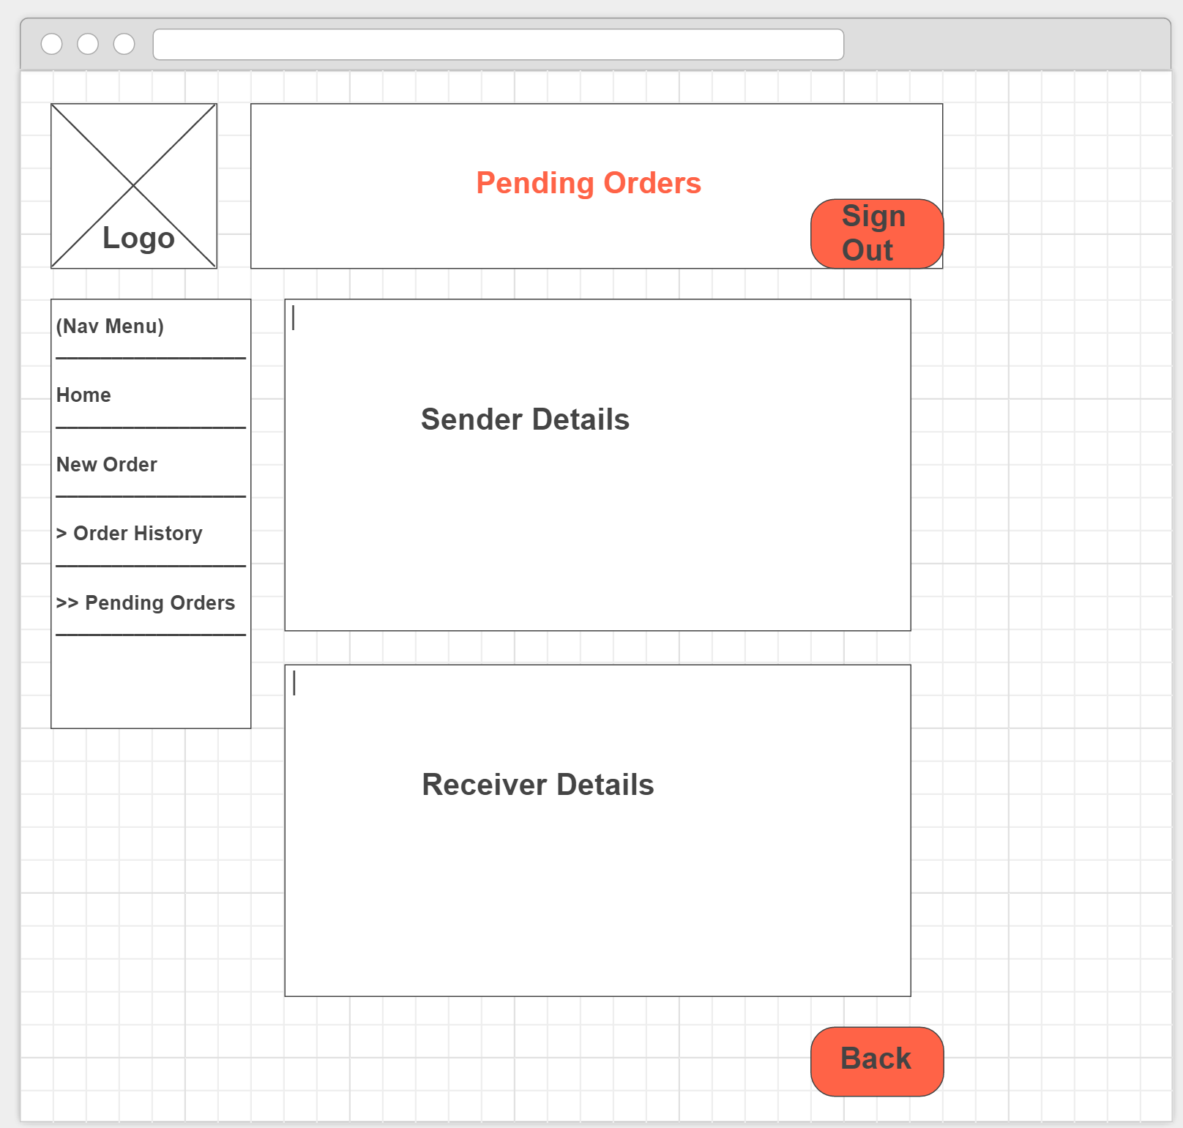

Slide 19
Completed Orders
Sign Out
Nav Menu
Home
New Order
>Order History
>>Completed Orders
Order #: 123 Date:00/00/0000
Destination: 1/123 Queen Street, Brisbane 4000
Receiver: XYZ
Contact Number: 0400000000
Order #: 456 Date:00/00/0000
Destination: 456 Queen Street, Brisbane 4000
Receiver: XYZ
Contact Number: 0400000000
Order #: 789 Date:00/00/0000
Destination: 789 Queen Street, Brisbane 4000
Receiver: XYZ
Contact Number: 0400000000
(Click to view Order)

Slide 20


Slide 21
Completed Orders
Sign Out
Nav Menu
Home
New Order
>Order History
>>Completed Orders
Order: 123
Sender Details
First Name: | abc | Last Name: | Def
Business Name:
Contact: | 0400000001
Shop/Unit: |  | Street Number: | 123
Street Name: | Ann Street
Suburb/City: | Brisbane | Post Code: | 4000
Receiver Details
First Name: |  | Last Name:
Business Name: | CYX Pty ltd
Contact: | 04000000000
Shop/Unit: | 1 | Street Number: | 123
Street Name: | Queen Street
Suburb/City: | Brisbane | Post Code: | 4000
Delivery Status: | Completed | Completion Date: | 09/09/2016
Back

Slide 22


Slide 23
Internal Portal
Driver Profile
Owner Profile

Slide 24
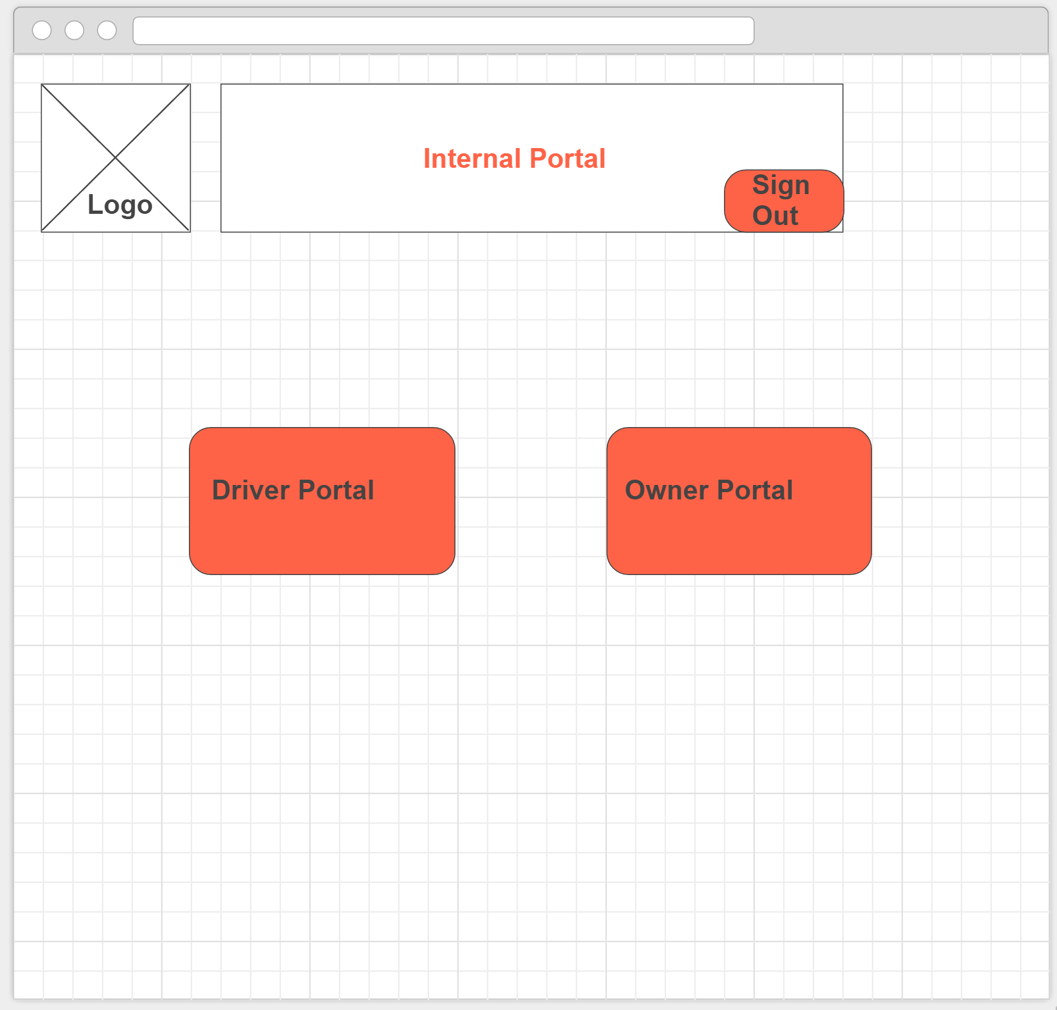

Slide 25
Driver profile
Sign Out
Pick-Up List
Delivery List

Slide 26
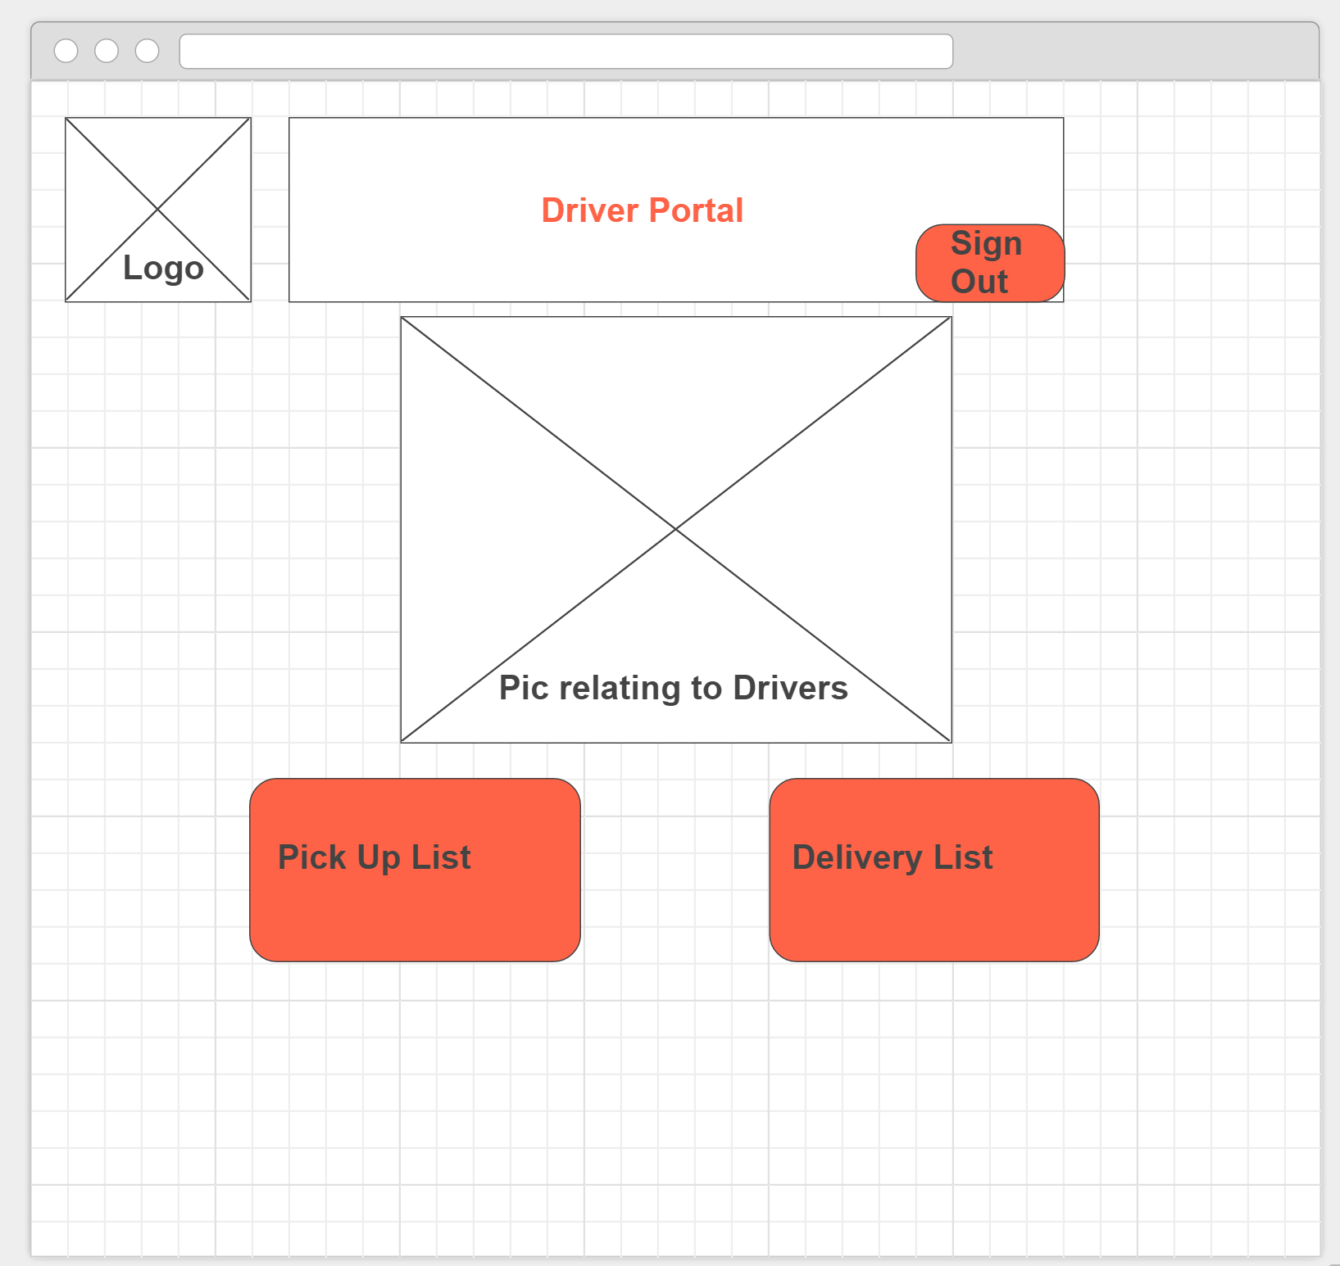

Slide 27
Pick-Up List
Sign Out
Nav Menu
Home
>Pick-Up List
Delivery List
Order #: 123 Submission Date:00/00/0000
Pick-up Site: 123 Ann Street , Brisbane 4000
Sender: abc def
Contact Number: 0400000001
Order #: 456 Submission Date:00/00/0000
Pick-up Site: 456 Ann Street, Brisbane 4000
Sender: abc def
Contact Number: 0400000001
Completed
Order #: 789 Submission Date:00/00/0000
Pick-up Site: 789 Ann Street, Brisbane 4000
Sender: abc def
Contact Number: 0400000001
(Click to view Order)

Slide 28
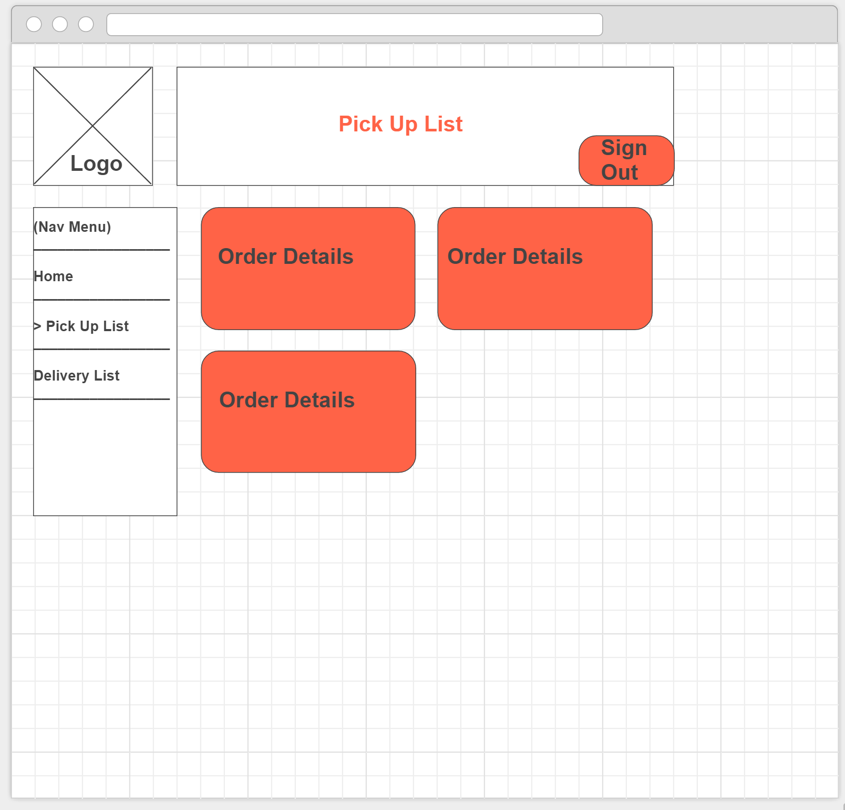

Slide 29
Pick-Up List
Sign Out
Nav Menu
Home
>Pick-Up List
Delivery List
Order: 123
Pick-Up Details
First Name: | abc | Last Name: | Def
Business Name:
Contact: | 0400000001
Shop/Unit: |  | Street Number: | 123
Street Name: | Ann Street
Suburb/City: | Brisbane | Post Code: | 4000
Weight: |  | Price Quote:
Pick-Up Status:
Completed
Back

Slide 30
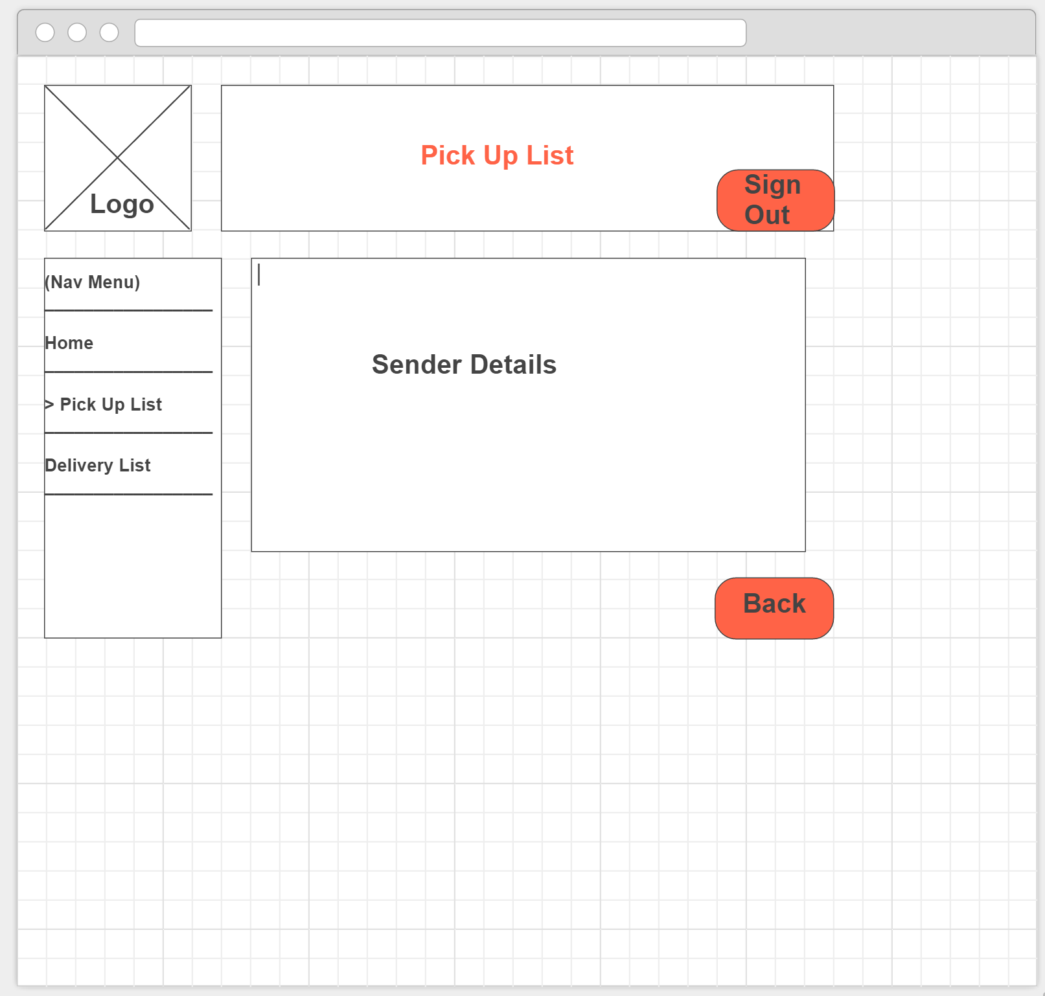

Slide 31
Delivery List
Sign Out
Nav Menu
Home
Pick-Up List
>Delivery List
Order #: 123 Submission Date:00/00/0000
Destination: 123 Queen Street , Brisbane 4000
Receiver: XYZ Pty Ltd
Contact Number: 0400000000
Order #: 456 Submission Date:00/00/0000
Destination: 456 Queen Street, Brisbane 4000
Receiver: XYZ Pty Ltd
Contact Number: 0400000000
Completed
Order #: 789 Submission Date:00/00/0000
Destination: 789 Queen Street, Brisbane 4000
Receiver: XYZ Pty Ltd
Contact Number: 0400000000
(Click to view Order)

Slide 32
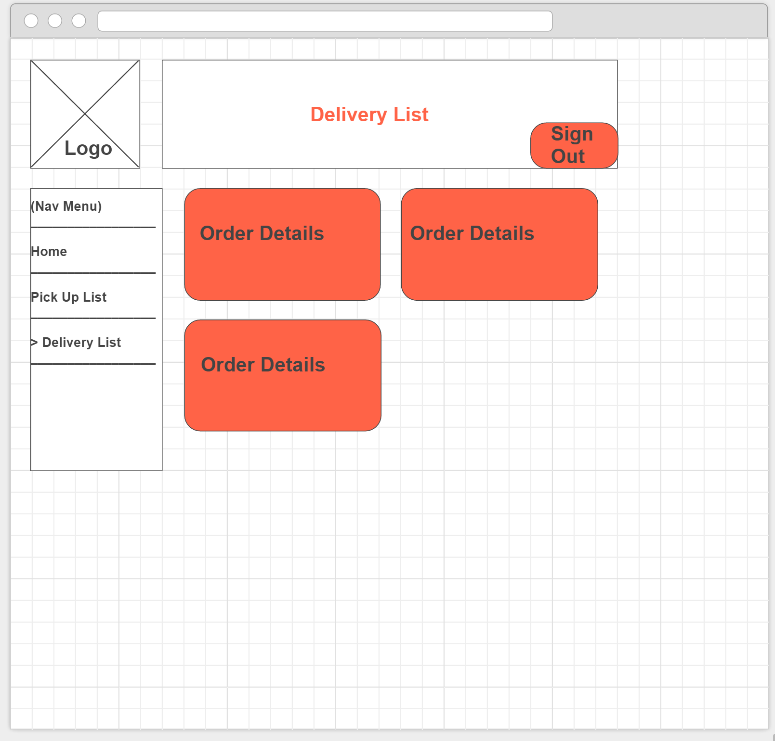

Slide 33
Delivery List
Sign Out
Nav Menu
Home
Pick-Up List
>Delivery List
Order: 123
Sender Details
First Name: | abc | Last Name: | Def
Business Name:
Contact: | 0400000001
Shop/Unit: |  | Street Number: | 123
Street Name: | Ann Street
Suburb/City: | Brisbane | Post Code: | 4000
Receiver Details
First Name: |  | Last Name:
Business Name: | CYX Pty ltd
Contact: | 04000000000
Shop/Unit: | 1 | Street Number: | 123
Street Name: | Queen Street
Suburb/City: | Brisbane | Post Code: | 4000
Delivery Status: |  | Estimated Delivery: | 09/09/2016
Completed
Back

Slide 34
